Slide 1
Query a Digital Music Store Database
Business Analytics

Slide 2
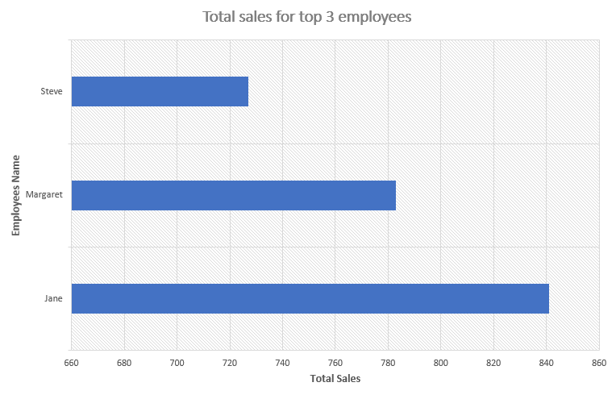
Which employee made the most sales?
The graph shows the top Sales for 3 employees , He was the highest employee from sales support agent jane made sales 841$

Slide 3
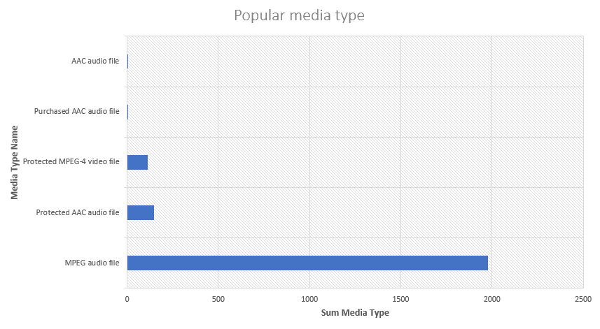
Which is the most popular media type?
The graph shows the most Popular media type , The most common media type is used is MPEG audio file with a total of 1976.

Slide 4
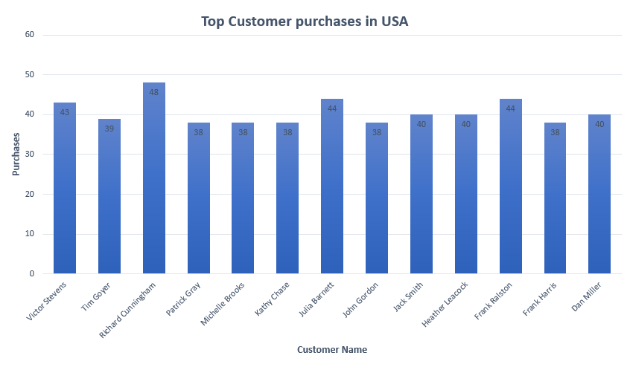
Which customer from the USA purchased the most?
The graph shows the purchases of 13 customers in the USA, and we see that the customer Richard has the most purchases by about 48.

Slide 5
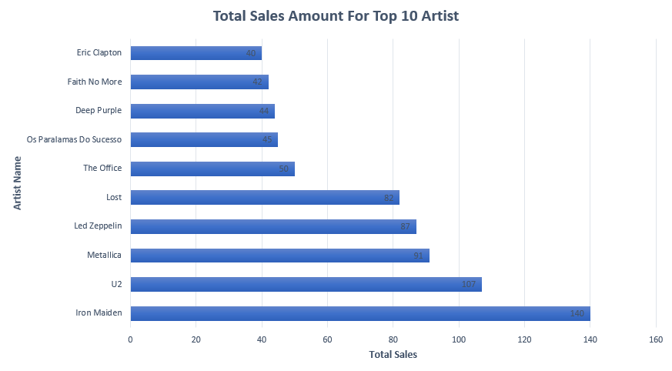
Which artist made the most sales?
The graph shows ten artists who have achieved high sales, and the highest-selling artist was Iron Maiden about 140.

